Slide 1
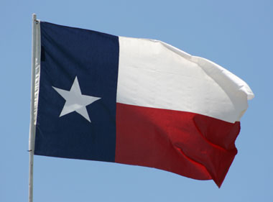
Early Settlement of Texas

Slide 2
Demographics
Mexico owns Texas after becoming an independent nation
Mexican citizens only live in the South portion of the state.
Very sparse population of Mexican that are very reluctant to move north. Why?

Slide 3
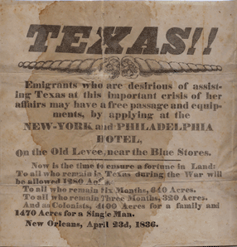
Bright Idea: Get the Americans to do it!
1823 to 1825 three laws passed to promote immigration to Mexico.
These laws offered cheap land to basically anyone willing to come and settle the lands.
Empresarios- Stephen Austin

Slide 4
continued
Rules of moving to Mexico and obtaining cheap or free land
Tax exempt for ten years on condition of 1. become a Mexican citizen 2. Live under Mexican Law 3. convert to Roman Catholicism.
Initial response was good to these laws
Location and culture lead to distrust of the new settlers. ( No Adoption of Mexican Customs, Church location)
This led to the eventual shutdown of the border of Texas(1830). Why would this infuriate the American Settlers?

Slide 5
Beginnings of War
Stephen Austin sent as contact to Mexico city to negotiate the lifting of policies including border and taxes on imports.
Santa Anna was stubborn and negotiations stalled
Intercepted letter from Austin to Texas (Peaceful Organization of own Government)
Treason
One year later Austin released Negations then Stale again. Santa Anna declares himself a dictator his word is law.

Slide 6
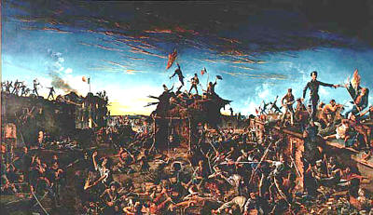
Independence

Slide 7
Early Texas Revolution
Austin sent letter stating to start an army, Santa Anna would not negotiate.
October 1835 east of San Antonio Mexican soldiers ordered Texans to surrender there arms. In response the rebels pointed a cannon at troops and raised a flag that read, “Come and Take It”
No attack rebels drive forces out of San Antonio
The Alamo Video - The Alamo - HISTORY.com

Slide 8
continued
Stats of Alamo (Santa Anna 6,000 troops, 186 citizen Texans, 13 days no survivors aside from a few women, children and servants, 600 dead or wounded Mexicans.)
Goliad – two weeks later Mexican army overwhelmed troops at Goliad
Surrender – result 300 died next morning by firing squad.
This is where remember the Alamo and Goliad came.

